Slide 1
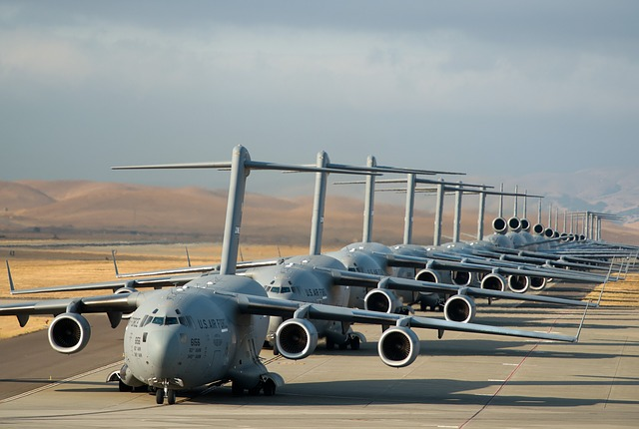
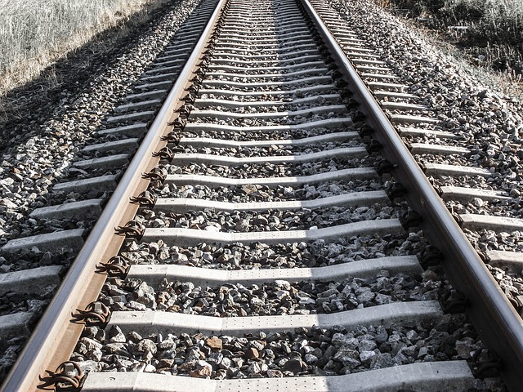
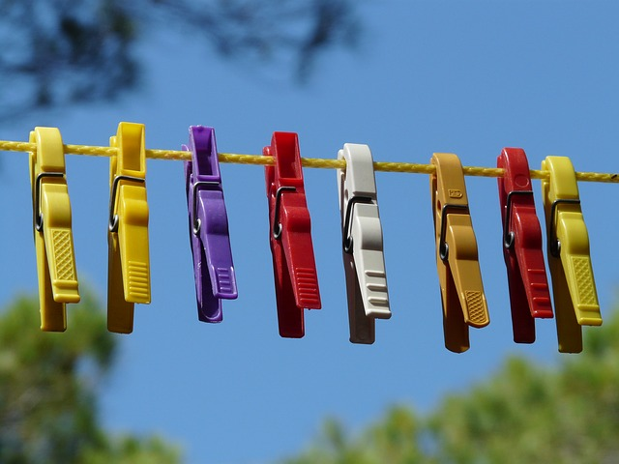
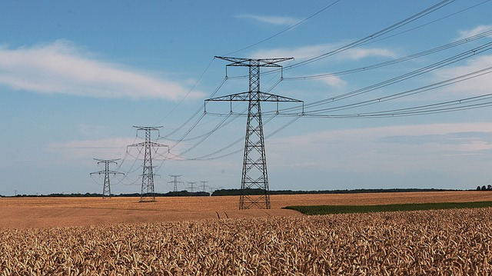
How to construct a History timeline
Pattern of intervals
Lines
Teacher Tip
Use slideshow mode.
Notes:
This slideshow explains how to construct a History timeline. The images here are obviously not History timelines but they do have something in common with them. Can you identify what this might be?
These are all images of (Click) lines (Click). We have a line of planes, (Click) a railway line, (Click) a clothes line (Click) and electricity lines (Click). What else do they have in common? (Pause 2 seconds) (Click) There is a pattern of regular intervals in each line. (Click). (Click) The planes are lined up with even spacing between each plane. (Click) The railway line has sleepers at precise intervals along the tracks. (Click) The clothes line has the pegs distributed evenly along the line (well, almost evenly) and (Click) the electricity lines have towers at regular intervals along the line.

Slide 2
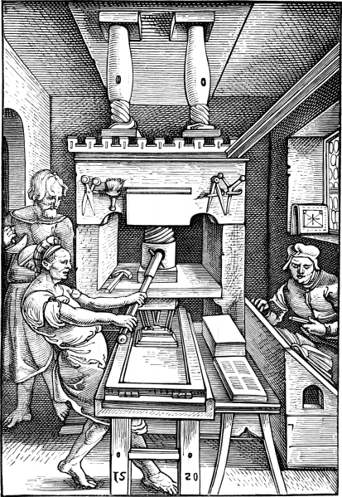
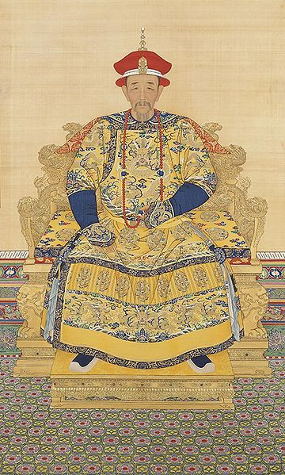
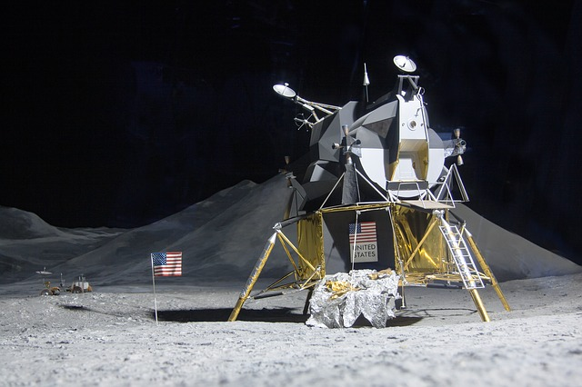
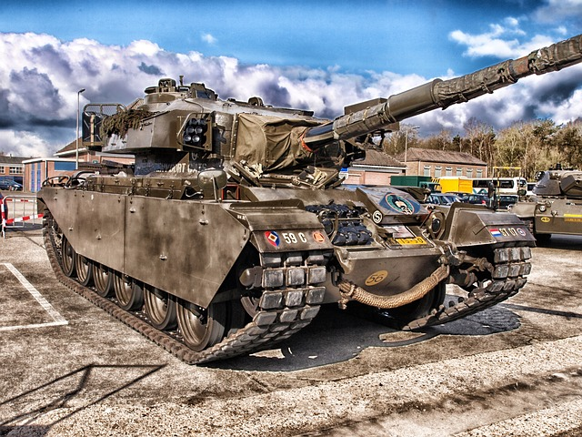
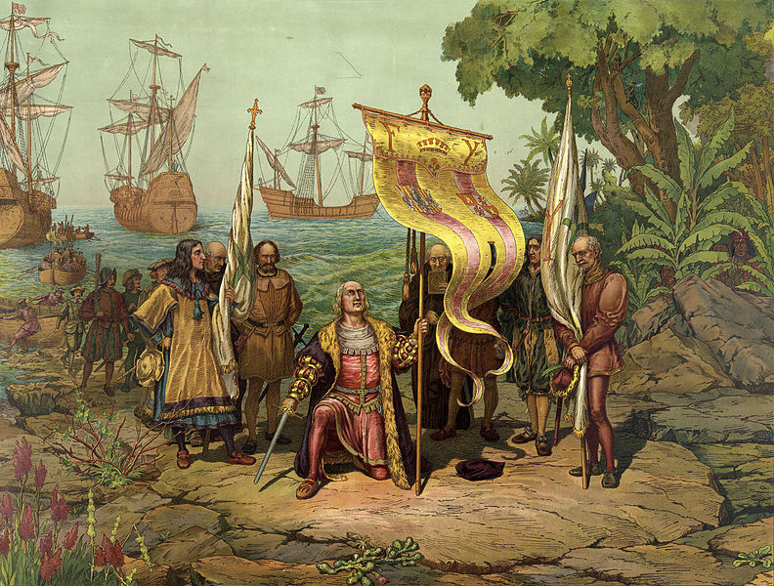
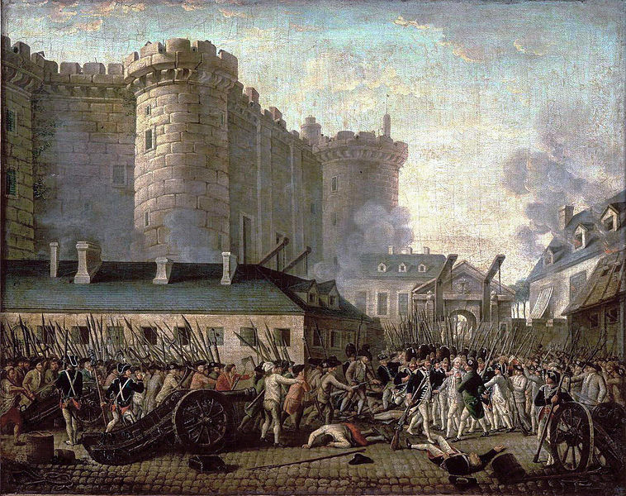
Printing press invented
First moon landing
Beginning of Qing Dynasty
1400
1500
1600
1700
1800
1900
2000
World War I
The Age of Exploration
The French Revolution
Notes:
A History timeline is also a line (Click) divided into precise intervals (Click). In this case, the intervals are not represented by pegs or railway sleepers but by (Click) dates.
History timelines are designed to show historical events and developments (Click and pause). These events and developments have to be arranged in chronological order along this line. Chronological order means the order in which the events occurred.

Slide 3
Timeline of Mary Irvine’s life
1948
Mary gets her first job as a secretary
1962
Mary becomes engaged to John
1991
Mary’s first grandchild born
1936
Mary begins school
1960 Mary awarded the University Medal
1930
Mary born 3 March
1981
Mary becomes a Judge
1999
Mary retires as a Judge
2014
Mary dies
Mary enters high school 1944
1954
Mary meets the Queen
1965 Mary has her first child
1930
1940
1950
1960
1970
1980
1990
2000
2010
2020
1961
Mary gets her first job in a law firm
1933
Mary’s sister born
1971 Mary becomes a full partner in her law firm
1990
Mary promoted to the Supreme Court
1946
Mary achieves first place in a piano competition
1964
Mary marries John
1956 Mary begins a University Law Degree
Notes:
Here is a completed timeline showing the life of an imaginary person called Mary Irvine. Mary was born in 1930 and died in 2014. This means Mary was 84 when she died. You will note that the events of Mary’s life are located along this line (Click). This line is horizontal but it could also be a vertical line. You will also notice that the line is divided into equal parts (Click).
The events of Mary’s life are placed above and below the line because there is not enough room to put them all on one side of the line or beside each other along the line. Notice that each event has a date recorded so the exact date of each event is evident. You will also note that the timeline has a title.
The reason we arrange historical events along a line like this is because a timeline does more than show the order of events; it allows us to see patterns in the events. We notice on this timeline that Mary has nothing of note recorded after 1999, (Click) when she retired. The timeline does not tell us why but it might lead us to further investigation to determine why.

Slide 4
Step 1: Determine the minimum length of the timeline
Date | Event
1930 | Birth of Mary Irvine
1944 | Mary enters high school
1960 | Mary is awarded the University medal
1981 | Mary becomes a judge
1990 | Mary promoted to the Supreme Court
1999 | Mary retires as a judge
2014 | Death of Mary Irvine
84 years
Notes:
Let’s now explore this procedure step by step. (Click) First, we need to determine the minimum length the timeline needs to be. To do this, we need to calculate what period of time we have to represent. We do this by looking at the (Click) first date and the (Click) last date. Here is the list of some of the events in Mary’s life. The full list is not provided but just a sample, including the year of her birth and the year of her death. So how many years does our line need to represent? (Click) Subtract the year of her birth from the year of her death and you will see the figure is (Click) 84. We need to represent at least 84 years of time on the timeline.

Slide 5
Step 2: Draw the line
Notes:
(Click) We now have to draw a line so that all these years can be represented, which brings us to Step 2. How long should this line be? (Click) Your line can be whatever length you choose, but it needs to be long enough to allow you to include all the events you want to record, set out so that they are clearly identified. There is no point in having a short line if you are not going to be able to fit everything on it. A good rule of thumb is to fill up whatever space you have. For example, if you are using a piece of paper, then it might be a good idea to either turn the paper on its side and use the whole length horizontally or leave it as is (Click) and draw a vertical line.

Slide 6
Step 3: Divide the timeline into equal intervals of time
90
1930
2020
10 years
10 years
10 years
10 years
10 years
10 years
10 years
10 years
10 years
Notes:
Now that you have drawn your line, (Click) you need to divide it into equal intervals of time. You have already determined that you have to represent at least 84 years, but a line on a page is not long enough for you to divide it into 84 portions. We are used to calculating in lots of 5 or 10, so in this case, the line has been divided into 9 equal portions representing 10 years each. In this way, (Click) 90 years of time is shown on the line. When you’re calculating your interval spacing on paper, it is helpful to use the centimetre intervals on your ruler. In this example, 10 years is represented by intervals of approximately 2.5 cm. Let’s use some other examples to help you do this yourself.

Slide 7
Step 4: Record the appropriate dates on each time interval
1930
1940
1950
1960
1970
1980
1990
2000
2010
2020
Notes:
Once the length of the line has been determined, and the timeline divided into equal intervals of time, (Click) it is now time to record the appropriate dates on the intervals. As we determined earlier, each interval represents 10 years. Starting with the first date, which is 1930, (Click) you can begin recording the dates on the timeline in ascending order from left to right, (Click) 1940, 1950, 1960, and so on through to 2020.

Slide 8
Date | Event
1930 | Birth of Mary Irvine
1944 | Mary enters high school
1960 | Mary is awarded the University medal
1981 | Mary becomes a judge
1990 | Mary promoted to the Supreme Court
1999 | Mary retires as a judge
2014 | Death of Mary Irvine
Step 5: Plot the events in the correct place on the timeline
2014
Mary dies
1930
Mary is born
1960
Mary is awarded the University medal
1990
Mary promoted to the Supreme Court
1930
1940
1950
1960
1970
1980
1990
2000
2010
2020
4 years
6 years
1944
Mary enters high school
1999
Mary retires as a judge
1981
Mary becomes a judge
Notes:
Now that you have recorded the dates on the timeline, the next step is to (Click) plot the events in the correct place on the timeline. Remember, earlier it was mentioned we would be looking at only a few key events during Mary Irvine’s life. (Click) Here they are again to remind you.
You will notice that some of the dates where you need to record events are indicated on the timeline, but this may not always be the case. For example, (Click) The years 1930, 1960, and 1990 have been recorded as intervals on the timeline. (Click) This makes it very easy to record the events accurately on the timeline. (Click) 1944, 1981, 1999 and 2014 are not marked on the timeline. In this case, it is very important that you use the dates on the intervals as a guide to help you plot the events correctly.
Let’s have a look at how to plot the event of 1944 on the timeline as an example. (Click) 1944 falls between the 1940 and 1950 intervals so this event has been plotted on the timeline in the middle of the two dates but slightly closer to the 1940 interval. Remember each interval represents 10 years so this position indicates that the event happened (Click) four years after 1940 but six years before 1950 (Click). Now, let’s place the rest of the events from the table on the timeline. (Click) (PAUSE 3 seconds)

Slide 9
Step 6: Give your timeline a title
Timeline of Mary Irvine’s life
2014
Mary dies
1930
Mary is born
1960
Mary is awarded the University medal
1990
Mary promoted to the Supreme Court
1930
1940
1950
1960
1970
1980
1990
2000
2010
2020
1944
Mary enters high school
1999
Mary retires as a judge
1981
Mary becomes a judge
Notes:
Your timeline is almost complete. (Click) The last thing left to do is to give your timeline a title. The title for your timeline needs to reflect what the information on the timeline is about. As the events we listed were about important events that happened throughout Mary’s life, the title for this timeline can be as simple and straightforward as (Click) Timeline of Mary Irvine’s life. So here you have it, a completed historical timeline.

Slide 10
SUMMARY
1. Determine the minimum length of the timeline.
A timeline is a line on which important events or developments are put in time order or chronological order.
2. Draw the line.
3. Divide the timeline into equal intervals of time.
4. Record the appropriate dates on each time interval.
5. Plot the events in the correct place on the timeline.
6. Give the timeline a title.
Notes:
Here is a recap of the important information covered in this slideshow. (Click) A timeline is a line on which important events or developments are put in time order or chronological order. There are six key steps involved in constructing a historical timeline. (Click) Step 1 is to determine the length of the line. (Click) Step 2 is to draw the line. (Click) Step 3 is to divide the timeline into equal intervals of time. (Click) Step 4 involves recording the appropriate dates on each interval of time, followed by (Click) Step 5, placing the events in the correct place along the line. (Click) The final step in constructing a timeline is to give it a suitable title.

Slide 11
Attributions
Slide 1
Line of planes http://pixabay.com/en/airplanes-lined-up-takeoff-cargo-566260/
Railway lines http://pixabay.com/en/train-track-pebble-railway-traffic-365453/
Clothes line http://pixabay.com/en/clothespins-clothes-line-dry-sky-9272/
Electricity lines http://pixabay.com/en/electricity-power-line-cable-384198/
Slide 2
Printing press 1520 https://commons.wikimedia.org/wiki/File:Press1520.png
Moon landing http://pixabay.com/en/moon-landing-lunar-module-eagle-193761/
Portrait of the Kangxi Emperor in Court dress https://commons.wikimedia.org/wiki/File:Portrait_of_the_Kangxi_Emperor_in_Court_Dress.jpg
Tank http://pixabay.com/en/tank-centurion-mk5-historic-history-143400/
Columbus taking possession of the new country, Library of Congress http://hdl.loc.gov/loc.pnp/cph.3b49587
French revolution https://commons.wikimedia.org/wiki/File:Anonymous_-_Prise_de_la_Bastille.jpg
All other images © DET

